Slide 1
Lunch & Learn
Kevin Li, Cheng Lyu and Quico Spaen
01/29/2016

Slide 2
What is “Lunch & Learn"
We need more communications and collaborations.
Our research is very diverse compare to other departments, we can share models/methodologies to enhance each others’ research.
Restoration of an old tradition.

Slide 3
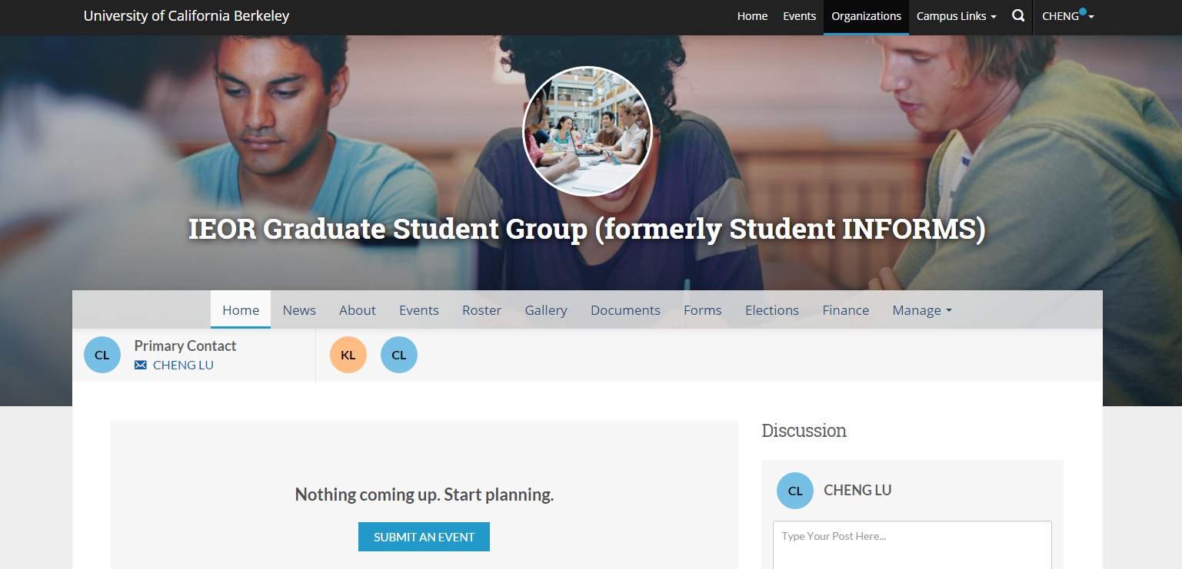
IEOR Graduate Student Group (IEOR GSG)

Slide 4
Tentative Schedule
Date & Time | Topics
Jan. 29 | (High-level) Introduction to Git and Python
Feb. 12 | Research and Career Panel
Feb. 26 | Deeper Introduction to Python and IPython Notebook
Mar. 11 | Interior Point Method, ADMM, and CVX for Convex Optimization
Apr. 1 | PANDAS for Time Series for Finance and Portfolio Optimization
Apr. 15 | SVM, Neural Networks and Clustering

